Slide 1
Enhancing Learning in Practice
Connecting, Establishing, Expanding

Slide 2
Connecting
Orientation Packs
Orientation packs help learners understand the area and types of patients/service users.
What type of information do you provide for learners?
Identify 3 sources of information / guidance that should be included in an orientation pack?
What type of information should you include about learning and assessment in your area? (consider the requirements of standards set by professional and regulatory bodies)
© Copyright STEPapproachlearning 2019.
www.stepapproach-learning.org @STEPMDX

Slide 3
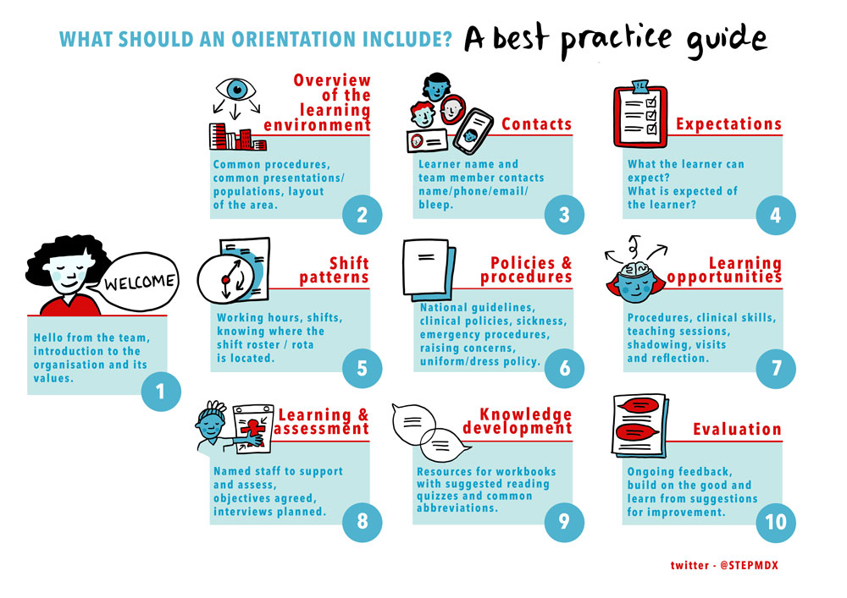
Connecting
A ‘best practice guide’ to orientation
Think of the whole process of orientation to the area and everything the learner needs to become familiar with.
Do you think all of these stages are relevant?
Why do you feel these are important to student orientation and socialisation to your area?
How will you ensure consistency of supervision and support during the learners experience?
© Copyright STEPapproachlearning 2019.
www.stepapproach-learning.org @STEPMDX

Slide 4
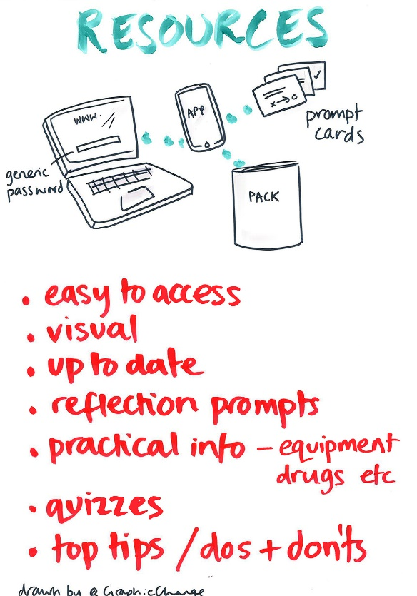
Connecting
Helpful learning resources
Learners like resources to be up to date, visual and easy to access.
Consider any resources you have in your area. Do they meet these criteria?
Look at some of the examples suggested by a group of learners.
Are any of these available in your area?
How might you develop some additional resources in your area?
Could your learners help you develop some resources ? How might you plan for this?
© Copyright STEPapproachlearning 2019.
www.stepapproach-learning.org @STEPMDX

Slide 5
Establishing
Setting learning objectives
Learning objectives shape learner development and achievement but must be realistic for both the learner and supervisor/s.
What approach do you currently take to setting learning objectives?
What information do you need as a supervisor to enable you to set realistic learning objectives?
How do you make learning objectives meaningful to motivate the learner to learn and achieve?
© Copyright STEPapproachlearning 2019.
www.stepapproach-learning.org @STEPMDX

Slide 6
Establishing
Learning objectives as part of a learning plan
Agreeing a learning plan with the learner is key to planning a positive experience and should include:
Learning objectives that reflect the knowledge needed, the level of performance required as well as the attitudes/ values the learner should display.
Understanding of the learner’s assessment requirements must be evident.
Understanding of individual’s learning needs and the appropriate and available learning opportunities
Setting clear and realistic timescales with the learner with planned opportunities for discussion, evaluation and feedback?
Reflect on an initial interview you recently conducted. Did you consider the above areas in agreeing a learning plan for the placement? How might you enhance your future practice?
© Copyright STEPapproachlearning 2019.
www.stepapproach-learning.org @STEPMDX

Slide 7
Establishing
Creating a positive learning environment
Learners identified these words as key to a good learning environment. These words all influence the learners’ journey in practice.
Focus on 3 of the identified words and give examples of how you maintain this approach for all learners at all stages of their learning.
What one word would you use to describe a ‘good learning environment’ and explain why?
© Copyright STEPapproachlearning 2019.
www.stepapproach-learning.org @STEPMDX

Slide 8
Establishing
Enhancing Learning
Learners identified these words as being key to a good learning environment.
Think of examples of how you maintain this approach for all learners at all stages.
How does knowledge of the learners assessment requirements support their learning?.
How do you support learners in meeting their required competencies/ proficiencies?
© Copyright STEPapproachlearning 2019.
www.stepapproach-learning.org @STEPMDX

Slide 9
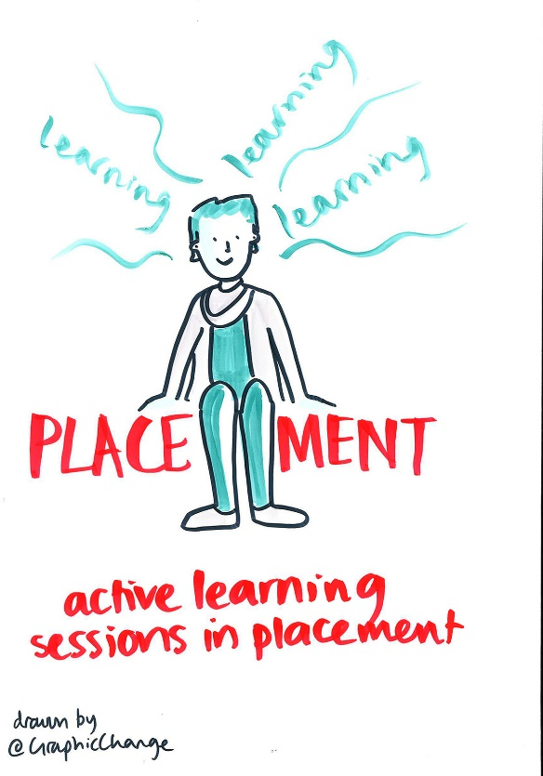
Expanding
Promoting Active Learning
Placements offer a vast range of learning opportunities.
What do you think ‘active learning’ means?
How can you use the current learning opportunities in your area to promote active learning?
Are there opportunities external to you area that the learner can access to promote their learning and development?
© Copyright STEPapproachlearning 2019.
www.stepapproach-learning.org @STEPMDX

Slide 10
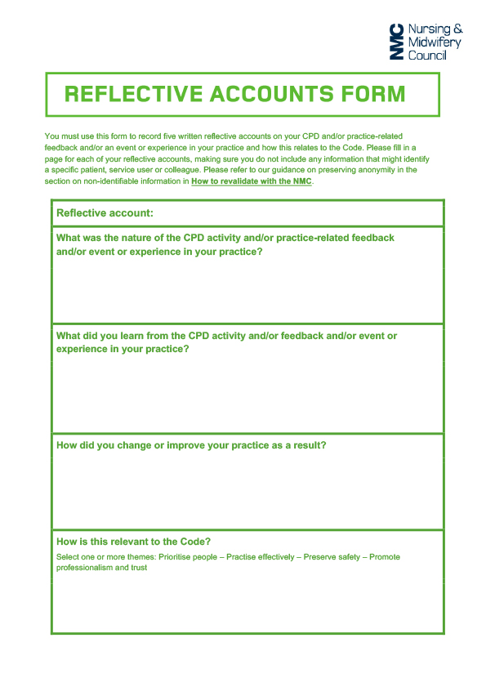
Expanding
Promoting Critical Reflection
Encouraging all learners to question their decision making and critically reflect on their experiences is essential to ongoing development.
What would be the benefits of asking your learners to complete a reflective account during their experience to encourage learning from their practice.
How could you use this reflection template to further enhance their learning?
© Copyright STEPapproachlearning 2019.
www.stepapproach-learning.org @STEPMDX

Slide 11
Expanding
Promoting a Team-based Approach
All members of the team can contribute to learning in practice.
Give examples of team members in your area that contribute to learning?
Do all these members understand their role in supporting learning?
What preparation and/or resources are available to help the wider team understand how they can contribute to the learning of others?
How might members of the team contribute to assessment?
© Copyright STEPapproachlearning 2019.
www.stepapproach-learning.org @STEPMDX

Slide 12
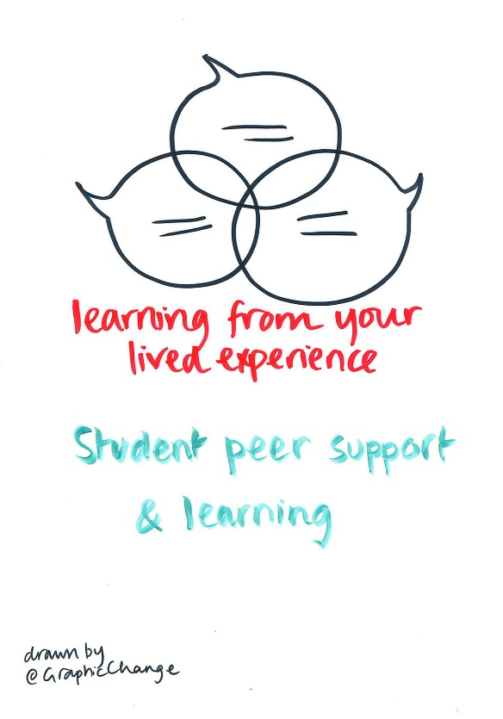
Expanding
Peer Learning
Learners can benefit from working with and learning from each other. Creating time for learners to share their experiences with others could benefit their learning.
Consider ways in which you could you promote peer learning and support in your area?
What preparation would learners need before taking on a role in the peer support and learning relationship?
How would you evaluate this approach?
© Copyright STEPapproachlearning 2019.
www.stepapproach-learning.org @STEPMDX

Slide 13
Expanding
Enhanced Support for Learning
These words were identified by a group of learners as most helpful approaches used in supporting their learning
What do these responses suggest about how best to support learners on placement?
Do these responses reflect your approach to supporting learners on placement?
If you had to choose one of these words to reflect your approach what would that be?
© Copyright STEPapproachlearning 2019.
www.stepapproach-learning.org @STEPMDX

